Slide 1
Agentic AI Workflow Automation
Dr. Ashwini Patil
Notes:
Change the logo in this slide with the new one

Slide 2
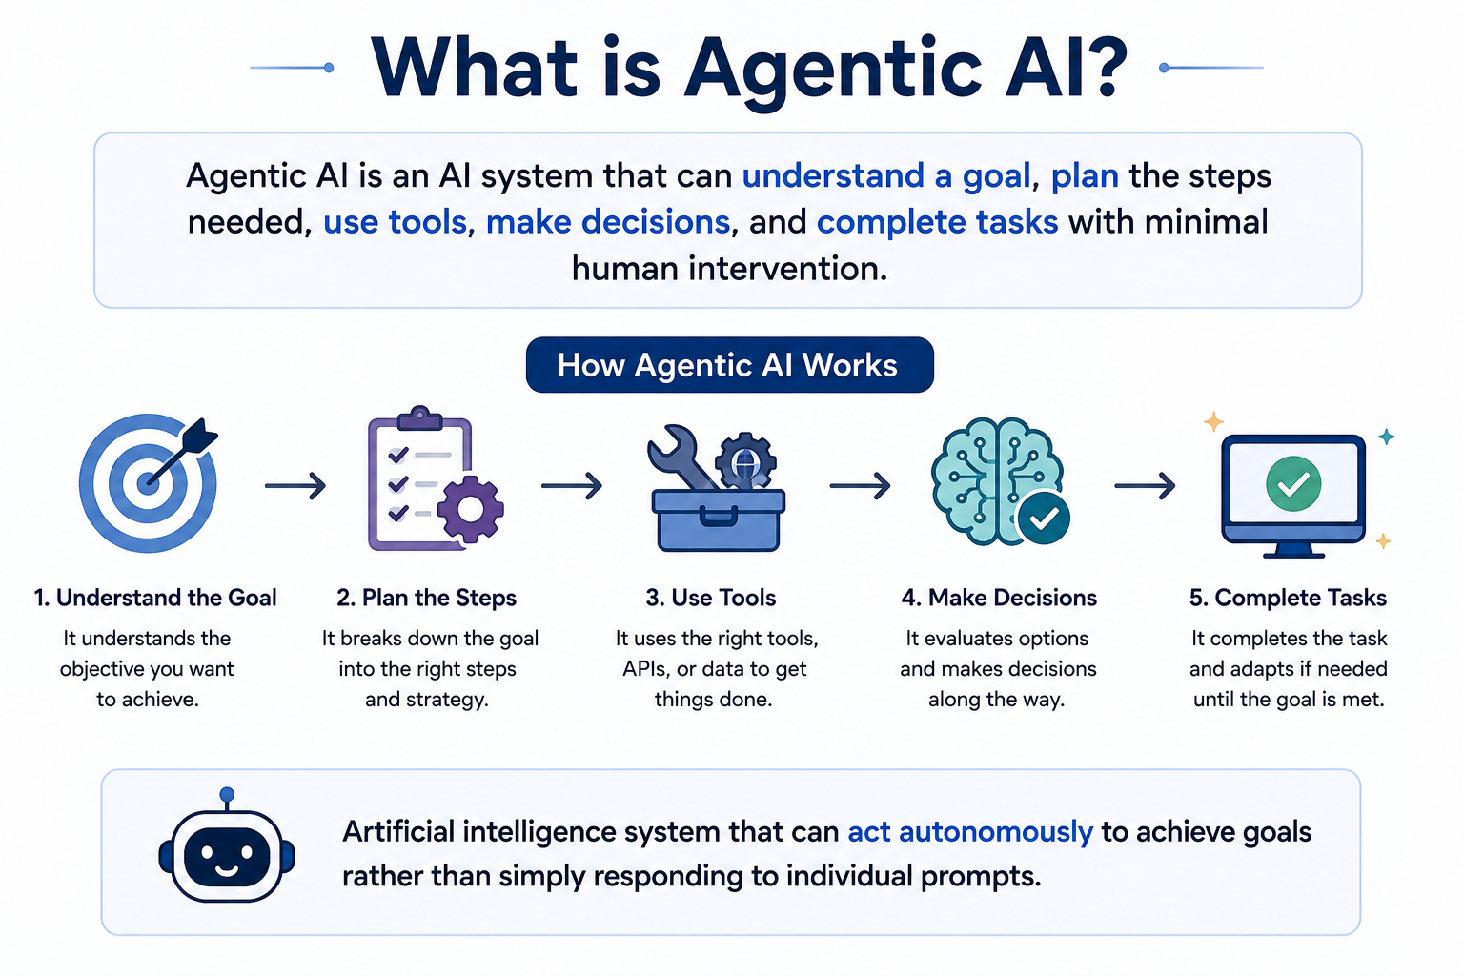
CHRIST
Deemed to be University
Excellence and Service
Notes:
Number of assessment 3 (even 2 assessments can be considered)
Total marks to be submitted to class teachers= 10 marks
No MCQ test for assessment
3 hrs per module (2+1)

Slide 3
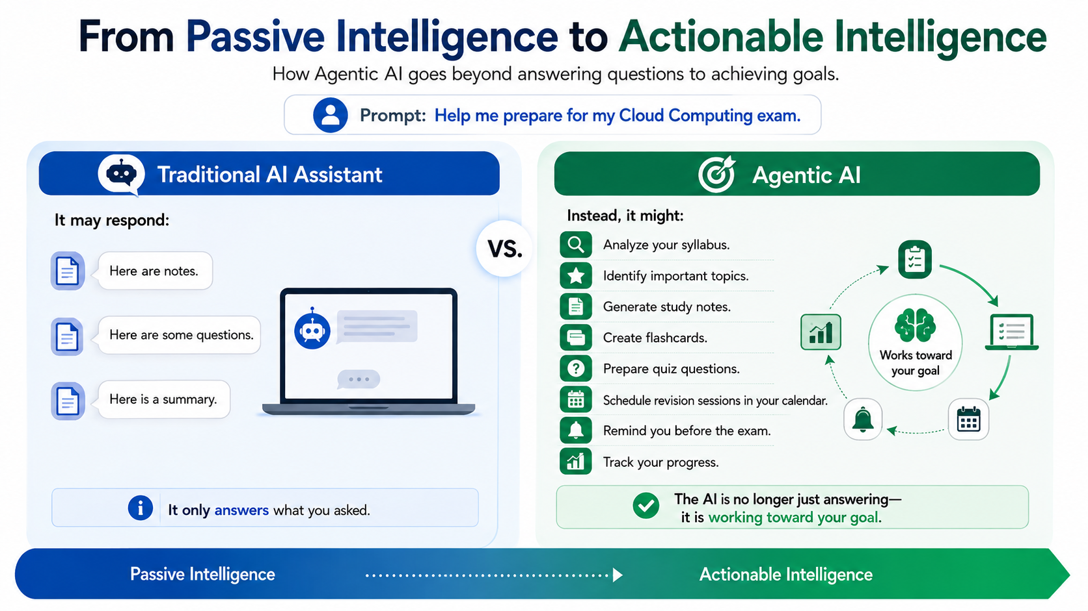
CHRIST
Deemed to be University
Excellence and Service
Notes:
Number of assessment 3 (even 2 assessments can be considered)
Total marks to be submitted to class teachers= 10 marks
No MCQ test for assessment
3 hrs per module (2+1)

Slide 4
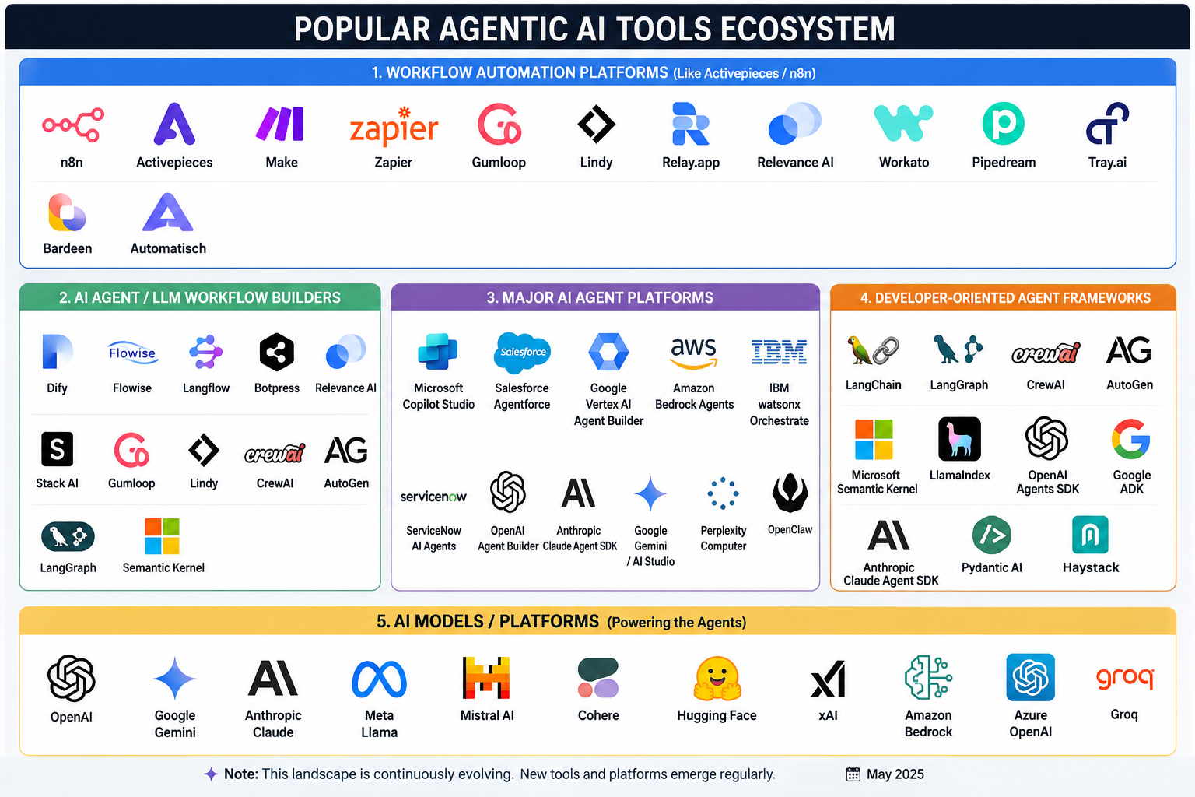

Slide 5
Work Flow Automation Tools
Hands-on Demo
Activepieces
Make
AI studio
Opal
Other popular tool to explore
Claude
N8n
Zapier

Slide 6
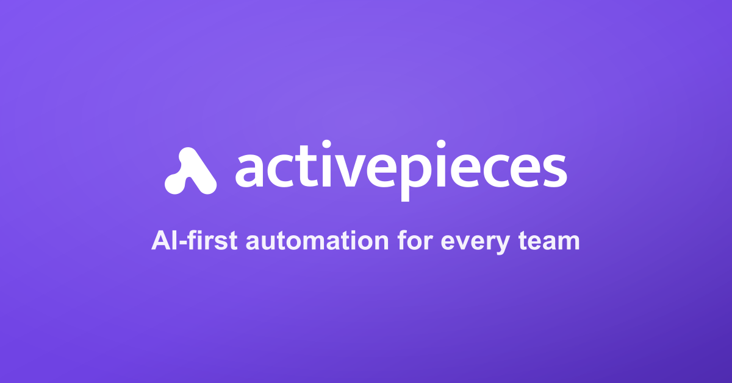

Slide 7
CHRIST
Deemed to be University
The Core Elements of Workflow Automation
Workflow automation is the structured execution of repeatable processes using predefined rules, designed to increase efficiency.
1
2
3
Triggers
The mandatory entry point or "spark" initiating a process, either event-based (like receiving an email) or scheduled (like daily syncs).
Actions
The specific automated tasks performed, such as sending immediate Slack notifications, updating CRM records, or triggering APIs.
Variables
Dynamic placeholders (e.g., {{user.name}}) that capture and route data from triggers to personalize workflow content dynamically.
Excellence and Service
Notes:
Number of assessment 3 (even 2 assessments can be considered)
Total marks to be submitted to class teachers= 10 marks
No MCQ test for assessment
3 hrs per module (2+1)

Slide 8
Demo - AI-powered automation
CHRIST
Deemed to be University
Use Case: AI-Powered Personalized Learning Assistant using Activepieces
Objective: An AI assistant that helps students plan their studies and provides daily personalized learning support by combining syllabus analysis, scheduling, and AI-generated study material.
Workflow 1: AI Academic Study Planner (Manual Initiation)
Purpose: Create a personalized study roadmap for the student.
Steps:
Manual Trigger – Student starts the planning process.
Read Course Syllabus (Google Docs) – Extract topics and learning objectives.
Read Student Preferences (Google Sheets) – Collect available study hours and preferred schedule.
Read Google Calendar – Identify free slots by checking existing events.
Gemini AI Analysis – Generate a conflict-free 30-day study plan.
Save Study Plan (Google Docs) – Store the personalized schedule.
Output: A structured 30-day learning roadmap.
Excellence and Service
Notes:
Number of assessment 3 (even 2 assessments can be considered)
Total marks to be submitted to class teachers= 10 marks
No MCQ test for assessment
3 hrs per module (2+1)

Slide 9
Demo
CHRIST
Deemed to be University
Workflow 2: AI Daily Learning Coach (Automatic Execution)
Purpose: Act as a personal AI tutor by delivering daily learning assistance.
Steps:
Schedule Trigger – Runs automatically every day.
Read Study Plan (Google Docs) – Fetch today's planned topic.
Gemini AI – Generate Learning Content – Creates:
Topic summary
Important concepts
Practice MCQs
Quick revision points
Motivation message
Gmail Notification – Sends personalized study material to the student.
Output: Daily AI-generated learning package delivered to the student.
Excellence and Service
Notes:
Number of assessment 3 (even 2 assessments can be considered)
Total marks to be submitted to class teachers= 10 marks
No MCQ test for assessment
3 hrs per module (2+1)

Slide 10
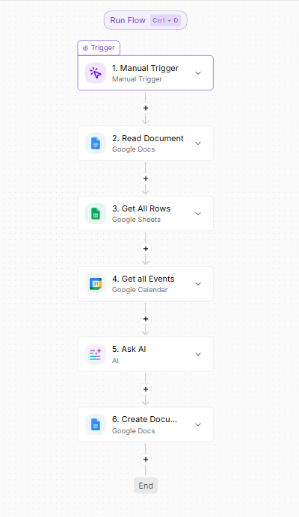
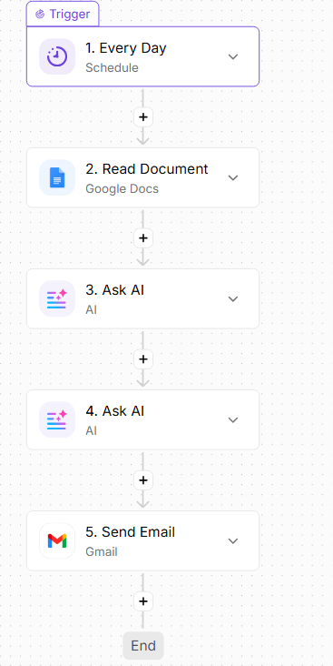
Demo
CHRIST
Deemed to be University
Excellence and Service
Notes:
Number of assessment 3 (even 2 assessments can be considered)
Total marks to be submitted to class teachers= 10 marks
No MCQ test for assessment
3 hrs per module (2+1)

Slide 11
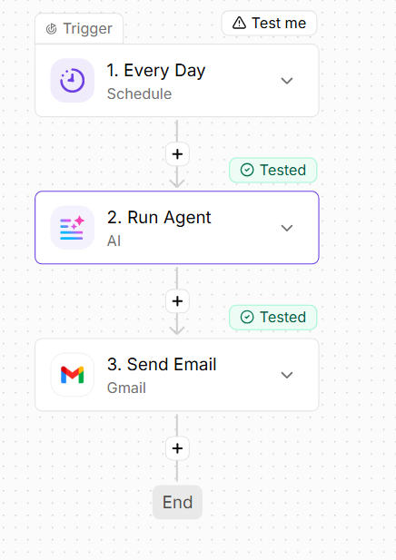
Demo - Agentic AI workflow
CHRIST
Deemed to be University
Use Case: Daily Digest: Auto-send a morning summary of meetings, tasks, and deadlines.
Workflow
Purpose: Automatically create a prioritized morning summary using meetings, tasks, and deadlines.
Steps:
Schedule Trigger – Runs every morning
AI Agent – Receives the goal and decides what information it needs
Google Calendar Tool – Retrieves meetings
Google Sheets Tool – Retrieves tasks and deadlines
AI Agent – Analyzes and prioritizes the information
Gmail – Sends the morning digest
Output: A personalized morning email summarizing meetings, urgent tasks, and upcoming deadlines.
Excellence and Service
Notes:
Number of assessment 3 (even 2 assessments can be considered)
Total marks to be submitted to class teachers= 10 marks
No MCQ test for assessment
3 hrs per module (2+1)

Slide 12
Ethical Use of Agentic AI
CHRIST
Deemed to be University
Use AI responsibly – Use AI to assist learning, not replace your own work.
Know its limitations – AI can make mistakes, misunderstand instructions, or provide outdated information.
Verify AI-generated outputs – Always check facts, calculations, code, and references before using them.
Protect privacy – Avoid sharing personal, confidential, or sensitive information with AI systems.
Be transparent – Acknowledge AI assistance when required by your institution or instructor.
Apply human judgment – Review and approve AI-generated decisions before acting on them.
Excellence and Service
Notes:
Number of assessment 3 (even 2 assessments can be considered)
Total marks to be submitted to class teachers= 10 marks
No MCQ test for assessment
3 hrs per module (2+1)

Slide 13
Verification of AI generated Output
CHRIST
Deemed to be University
Human-in-the-Loop: Mandatory human review of high-stakes AI outputs and complex automated decisions.
Ongoing Monitoring: Continuously tracking agentic performance to actively safeguard against data drift.
Strict Audits: Conducting regular system compliance audits and maintaining detailed documentation of AI use.
Data Governance: Enforce strict data governance policies—expressly avoiding the entry of sensitive or personally identifiable information (PII) into public models.
Excellence and Service
Notes:
Number of assessment 3 (even 2 assessments can be considered)
Total marks to be submitted to class teachers= 10 marks
No MCQ test for assessment
3 hrs per module (2+1)

Slide 14

CHRIST
Deemed to be University
Excellence and Service

